Slide 1
The Legislative Branch

Slide 2
Congressional Basics

Slide 3
Congressional Session
Both house of Congress must hold their session at the same time
Session begins on January 3rd.
Each session is a year long, with each Congress consisting of two sessions.
We are currently in the 116th Congress

Slide 4
Quorum
The minimum number of people required to do business
Both houses of Congress must have a quorum present on the floor to do business (51%)

Slide 5
The Congressional Record
A journal of everything that goes on while Congress is in session.
Both houses of Congress must keep a record of all debates and proceedings. The record is published by the United States Publishing office.

Slide 6
Rules and Punishment
Both houses make their own rules for behavior and punishments
Censure: formally reprimand, written in the record
Fines and penalties may be set for some offenses
Expulsion: members with gross misconduct may be thrown out of office
(requires 2/3 vote)

Slide 7
Salary
Rank-and-file
$174,000 per year
Majority and Minority leaders
$193,400 per year
Speaker of the House
$223,500

Slide 8
Benefits
Free office space
Free parking
Free trips to your home state
A budget for staff
A tax break on your second home
Franking privilege – you can send mail to your constituents for free!

Slide 9
Privileges
Immunity
Cannot be sued for anything you say or write while carrying out your duties
Cannot be arrested for minor offenses while Congress is in session
Restriction: May not hold another political office at the same time

Slide 10
Drawing District Lines

Slide 11
Apportionment
The process of determining the number of representatives for each state using census data

Slide 12
Redistricting
States’ redrawing of boundaries of electoral districts following each census.

Slide 13
Gerrymandering
The intentional use of redistricting to benefit a specific interest of group of voters.
Party gerrymandering – benefiting a particular political party.

Slide 14
Incumbency
Being already in office
As opposed to running for the first time

Slide 15
Incumbency advantage
Institutional advantages held by those already in office who are trying to fend off challengers in an election.

Slide 16
Congressional leadership
How to organize Congress

Slide 17
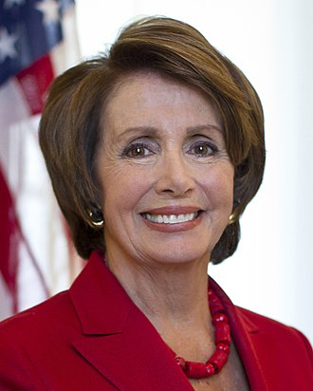
Speaker of the House
The leader of the House of Representatives, chosen by an election of its members.
Current Speaker is Nancy Pelosi
(116th Congress)

Slide 18
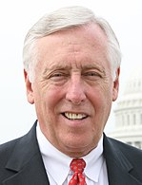
House Majority Leader
The person who is second in command in the House of Representatives.
Current House Majority Leader
Steny Hoyer
(116th Congress)

Slide 19
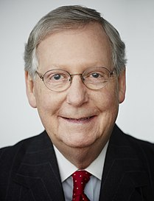
Senate Majority Leader
The person who has the most power in the Senate and is the head of the party with the most seats.
Current Senate Majority Leader
Mitch McConnell
(116th Congress)

Slide 20
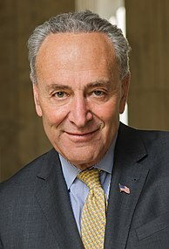
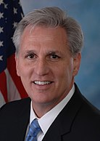
The Minority Leader (Senate and House)
The head of the party with the second-highest number of seats in Congress, chosen by the party’s members.
Senate Minority Leader
Chuck Schumer (D)
(116th Congress)
House Minority Leader
Kevin McCarthy (R)
(116th Congress)

Slide 21
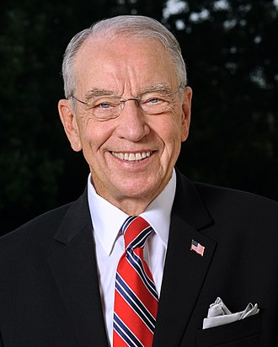
President Pro Tempore
The Senate member, elected by the Senate, who stands in as president of the Senate in the absence of the vice president.
Usually the longest serving member of the majority party.
Current President Pro Tem is Charles Grassley (116th Congress)

Slide 22
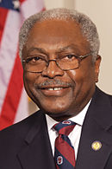
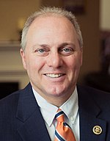
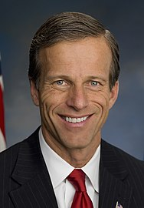
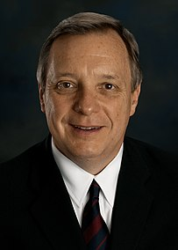
The Whip
A member of Congress chosen by his or her party members, whose job is the ensure party unity and discipline.
House Majority Whip
Jim Clyburn (D)
House Minority Whip
Steve Scalise (R)
Senate Majority Whip
John Thune (R)
Senate Minority Whip Dick Durbin (D)

Slide 23
Political Action Committee (PAC)
An organization that raises money for candidates and campaigns.

Slide 24
Committee Chair
Leader of a congressional committee who has authority over the committee’s agenda.

Slide 25
Congress by the Numbers
The demographics of the 116th Congress

Slide 26
Party Affiliation
The House
The Senate
Republicans
199
Democrats
235
Republicans
53
Democrats
47

Slide 27
Ethnic Makeup
House
Senate
313 - White
56 - Black
44 - Hispanic
15 - Asian
4 - Native American
89 - White
4 - Hispanic
3 - Black
3 - Asian
1 - Multiracial

Slide 28
By Gender
House
Senate
Men
330
Women
102
Men
75
Women
25

Slide 29
Religious Affiliation
House
Senate
Christian 385 (88.7%)
Jewish 26 (6%)
Buddhist 1 (0.2%)
Muslim 3 (0.7%)
Hindu 3 (0.7%)
Unitarian Universalist 2 (0.5%)
Unaffiliated 0
Did not disclose 14 (3.2%)
Christian 86 (86%)
Jewish 8 (8%)
Buddhist 1 (1%)
Muslim 0
Hindu 0
Unitarian Universalist 0
Unaffiliated 1
Did not disclose 4 (4%)

Slide 30
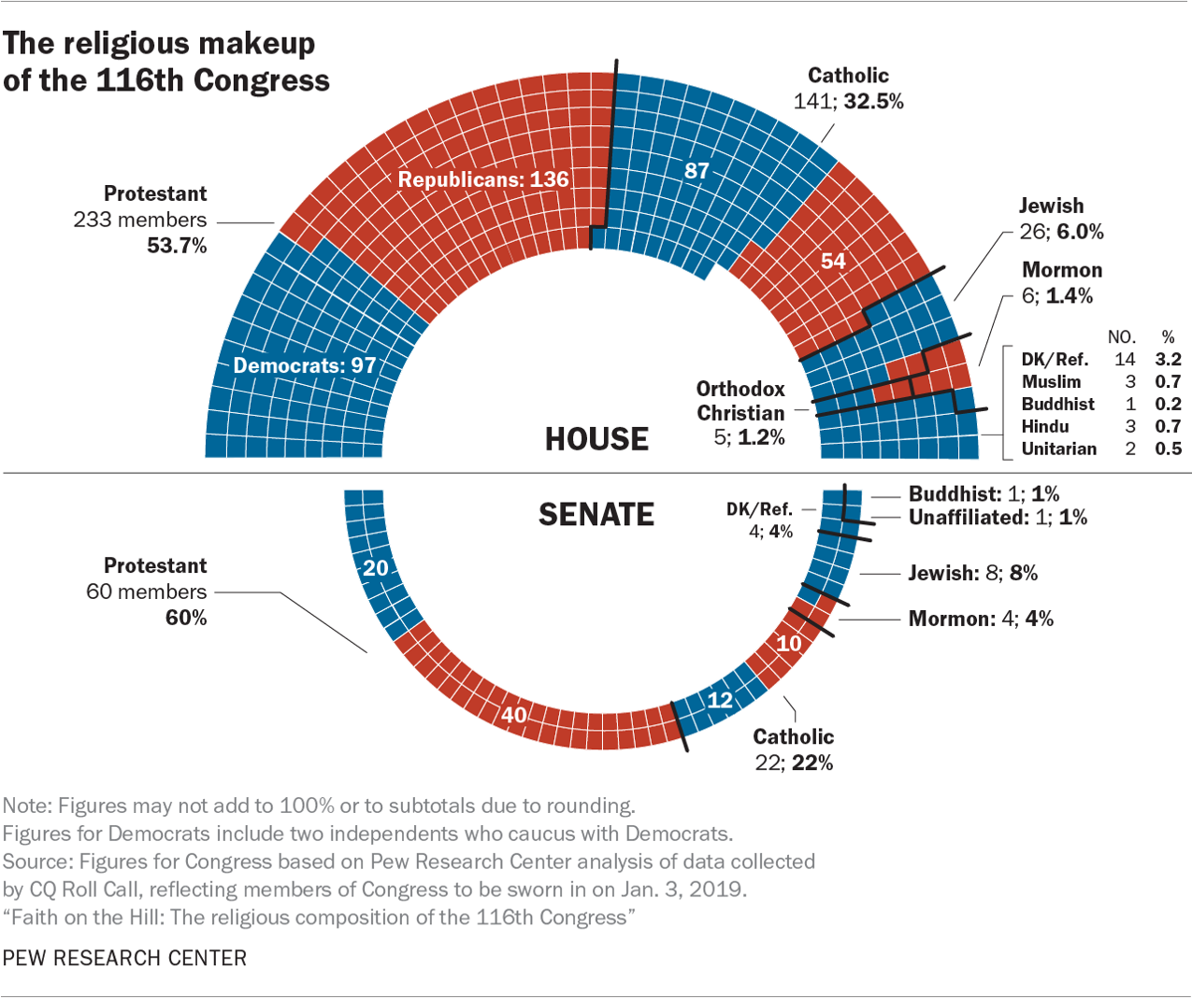

Slide 31
The most diverse Congress in history
116th Congress

