Slide 1
Federalism: National and State Powers

Slide 2
Delegated Powers
Powers the Constitution grants or delegates to the national (federal) government

Slide 3
Expressed Powers
Powers directly stated in the Constitution

Slide 4
Implied Powers
Powers that the government requires to carry out the expressed constitutional powers

Slide 5
Reserved Powers
Powers that belong strictly to the states

Slide 6
Concurrent powers
Powers that both the national government and the states have
Power is shared.

Slide 7
Inherent Powers
Powers that the national government may exercise simply because it is a government

Slide 8
Dual Federalism
(1790-1930) National and state governments were seen as equal authorities, operating over separate areas of influence.
Federal authority was generally limited to the expressed powers listed in the constitution.
Layer cake federalism

Slide 9
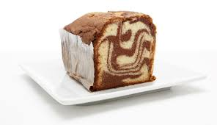
Cooperative federalism
(1930 – 1960) The national and state government shared functional authority in broad policy areas.
Marble cake federalism

Slide 10
Grants-in-aid
Federal funds given to state and local governments for specific projects.

Slide 11
Categorical grants
Federal grant that can only be used for a specific purpose, or category, of state or local spending.
Usually require the states to contribute money as well.

Slide 12
Block grants
Federal grants given to state and local governments for broad purposes, such as welfare, community development, public health or education.

Slide 13
Federal mandates
Regulations that the national government imposes on state and local governments.

