Slide 1
Why Government?
Hobbes, Locke and social contract theory

Slide 2
“If men were angels, no government would be necessary.” – James Madison

Slide 3
Brainstorm
Put yourself way back in time when humans lived in complete and unbridled freedom – a time that was void of any government what-so-ever. There was no government, but individuals did have their own morals and values.
Why did people create governments? What purpose does it serve?
How do you influence the government?
How do governments interact with their people?
Where do we (western society) get our ideas about government?

Slide 4
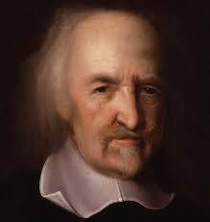
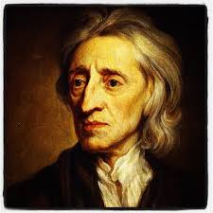
Hobbes and Locke
Men of the Enlightenment

Slide 5
Thomas Hobbes born 1588
English Scholar and philosopher
He became a tutor for a wealthy family – he had access to books, traveled often and met important thinkers.
He was interested in the nature of government and wrote about many topics – politics, geometry, physics, religion and history.

Slide 6
John Locke born 1632
Born in England about the same time that Hobbes was starting his work as a philosopher.
Thought about becoming a minister, started a career as a doctor, but ultimately ended up as a philosopher and political scientist.
His writings influenced Thomas Jefferson, who was instrumental in helping the United States gain independence from Britain (almost 150 years after Locke was born)
Locke’s ideas show up in the Declaration of Independence and The U.S. Constitution.

Slide 7
Hobbes
Humans are naturally selfish and quick to fight
Before governments – people lived in a state of nature where everyone had a right to everything
In order to get what they want, people would always be at war with everyone else.
No one would produce anything – they would be afraid other people would take them away.
Hobbes believed that a sovereign could take rights away from individuals in order to protect them.
Liked the idea of a monarchy – once people give up their power, they lose the right to overthrow the government.

Slide 8
Locke
Also believed without government, humans lived in a state of nature.
Believed we are all born with natural rights
Life
Liberty
Property
Locke believed that the government should provide protection to individuals, while protecting natural rights.
If the people disagree with the government, they have the right to overthrow or rebel.

Slide 9
Social Contract
The agreement between the people and the government that says that people need to give up their absolute right to do whatever they want. When you break this contract, the government can take away some natural rights. When the government breaks the contract, the leader can be impeached or a revolution may start.
In Hobbes’ view, the government protects the people and cannot be overthrown.
In Locke’s view, the government must still protect natural rights and can be over thrown.

