Slide 1
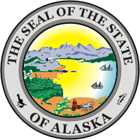
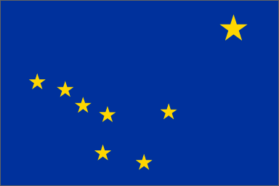
Fast Facts about Alaska

Slide 2
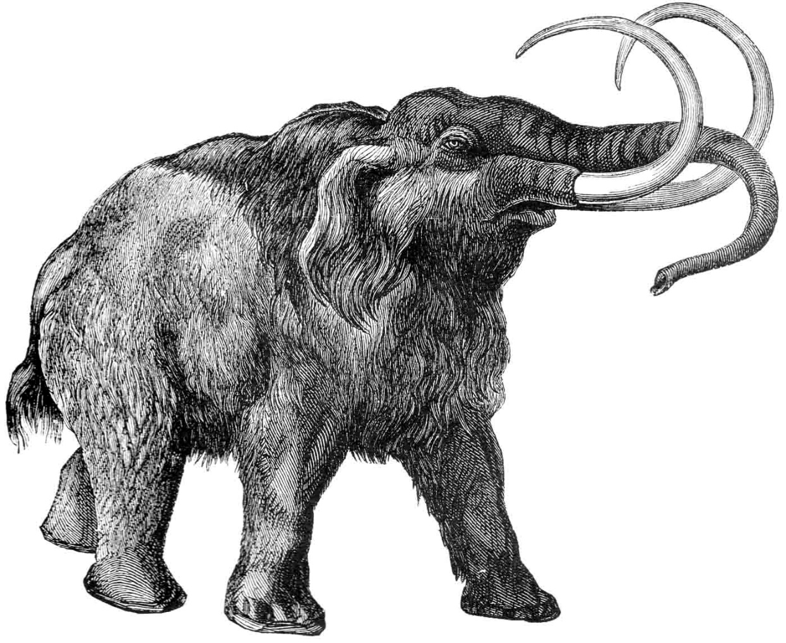
State Fossil
Wooly mammoth
adopted in 1986

Slide 3
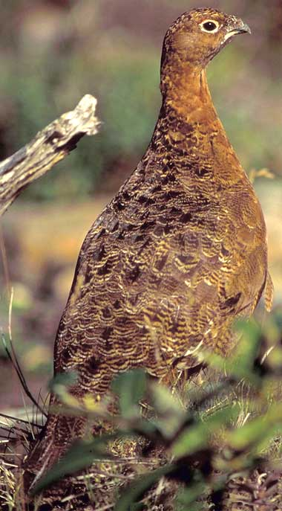
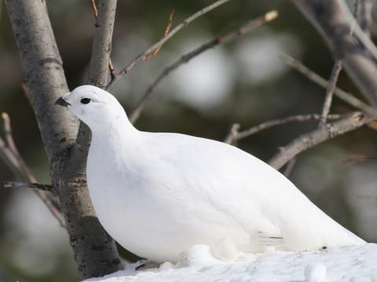
State Bird
Willow ptarmigan
adopted in 1955

Slide 4
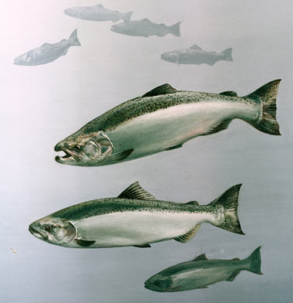
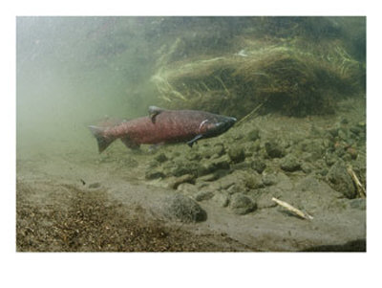
State Fish
King salmon
adopted in 1962

Slide 5
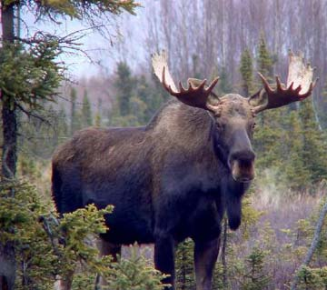
State Land Mammal
Moose
adopted in 1998

Slide 6
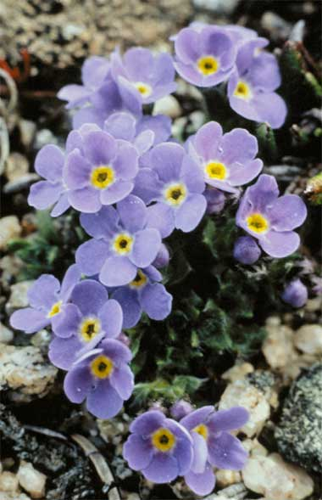
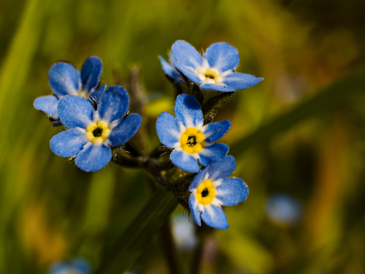
State Flower
Forget-me-not
adopted in 1949

Slide 7
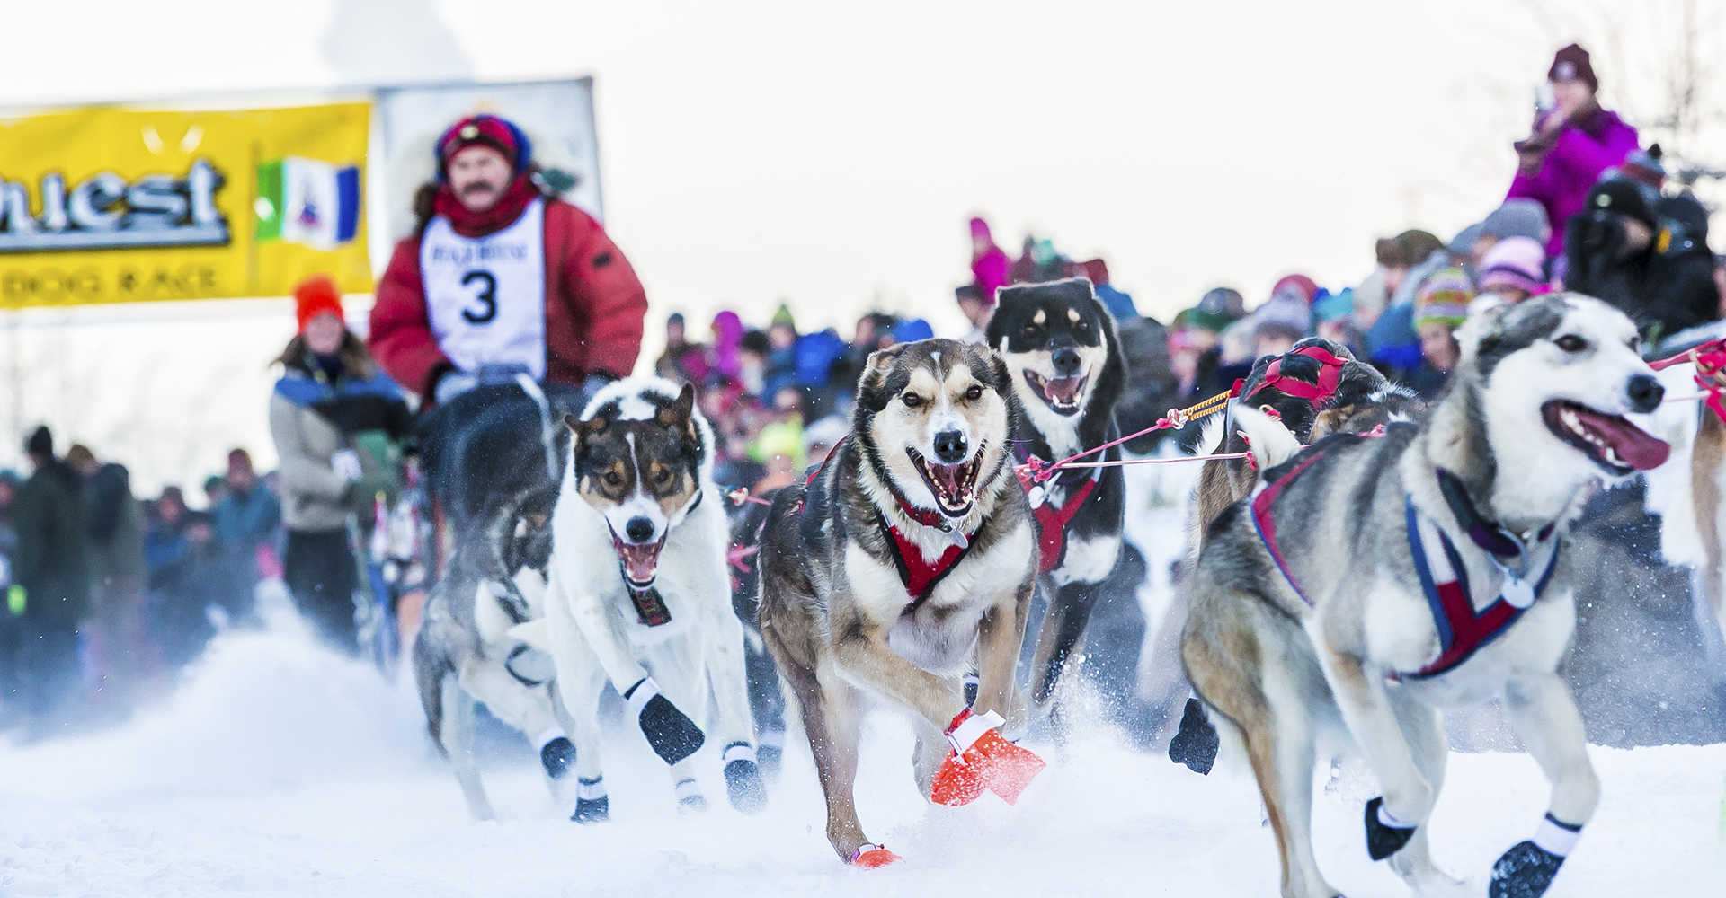
State Sport
Dog mushing
adopted in 1972

Slide 8
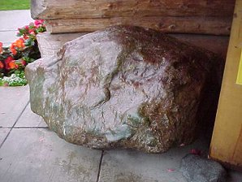
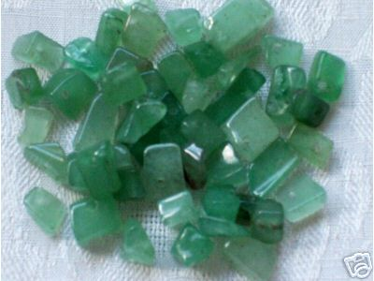
State Gem
Jade
adopted in 1968

Slide 9
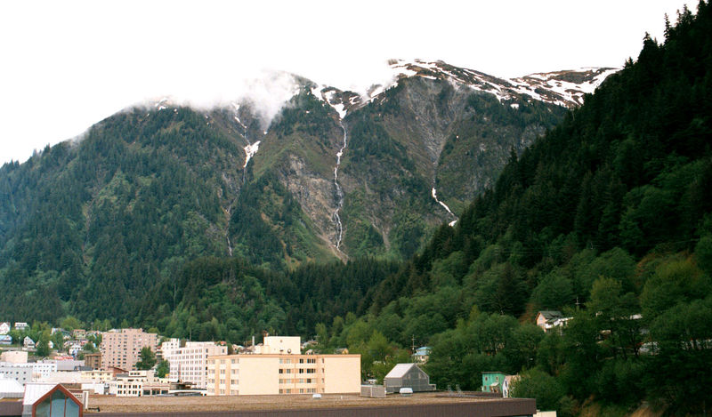
State Capital
Juneau

Slide 10
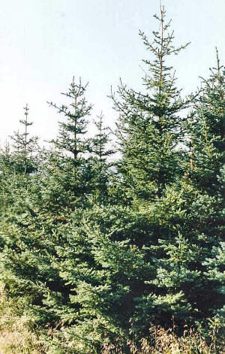
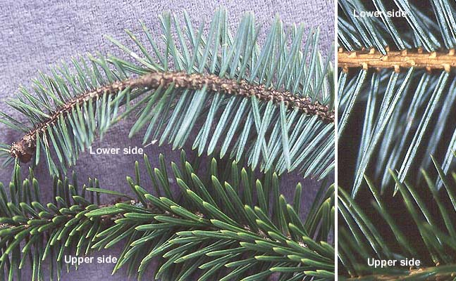
State Tree
Sitka Spruce adopted in 1962

Slide 11
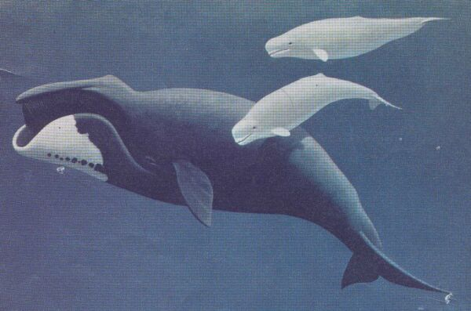
State Marine Mammal
Bowhead whale
adopted in 1983

Slide 12
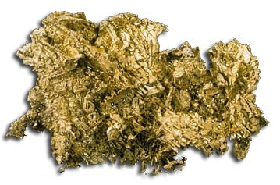
State Mineral
Gold
adopted in 1968

Slide 13
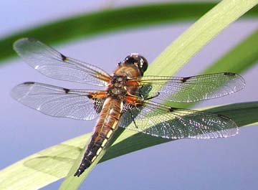
State Insect
Four-spot skimmer dragonfly
adopted in 1995

Slide 14
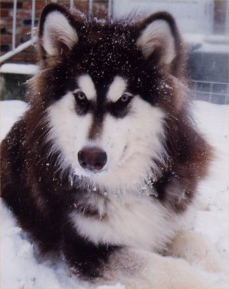
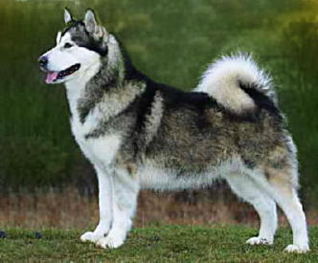
State Dog
Alaskan Malamute adopted in 2009

Slide 15
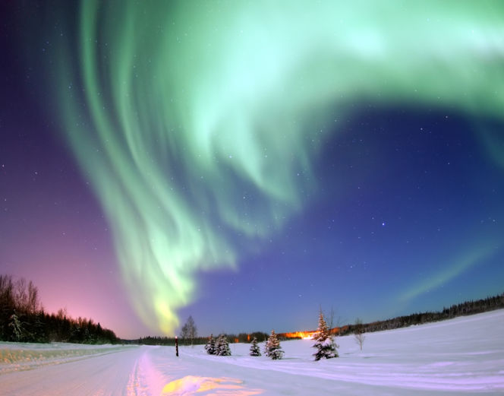
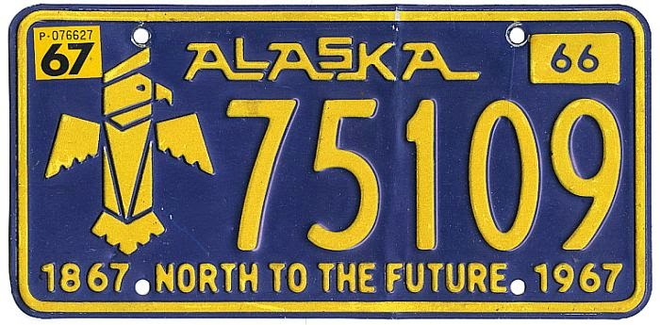
State Motto
North to the Future
adopted in 1967

Slide 16
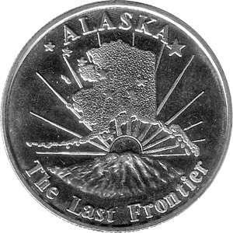
State Nickname
The Last Frontier

Slide 17
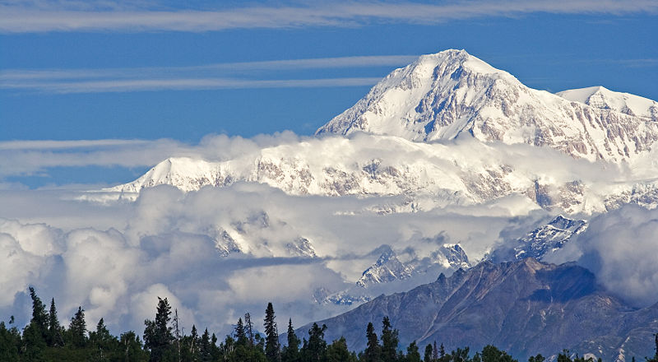
North America’s Tallest Mountain
Mount Denali is 20,320 feet

Slide 18
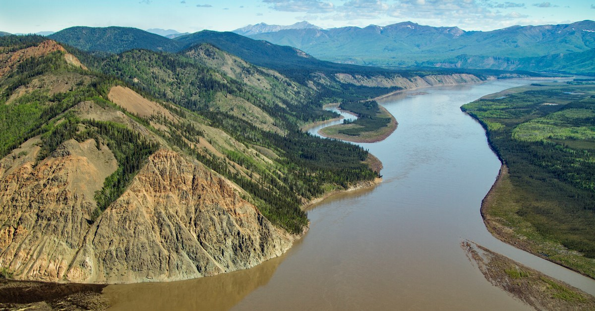
Alaska’s longest River
Yukon River
3,190 miles long

Slide 19
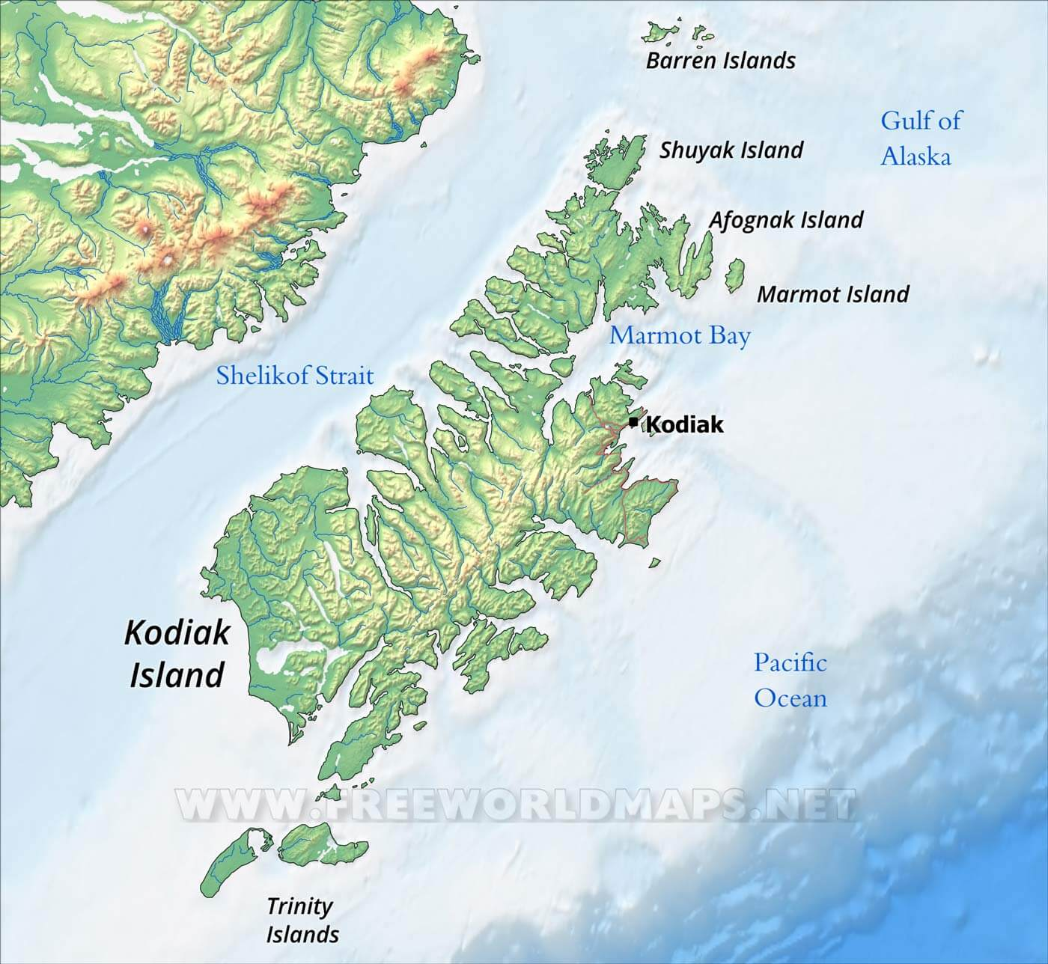
Alaska’s largest island
Kodiak Island

Slide 20
Important Years in Alaska History
Purchased from Russia in 1867
Organized as a Territory in 1912
Entered the Union as the 49th state in 1959

Slide 21
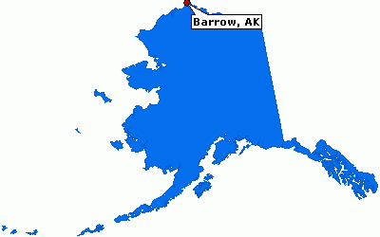
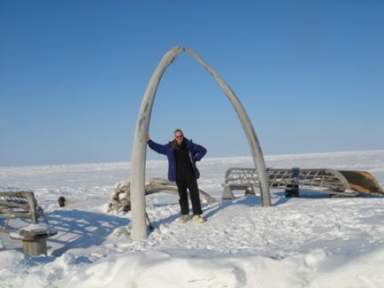
Nation’s Farthest-North Community
Barrow, Alaska is 350 miles north of the Arctic Circle

Slide 22
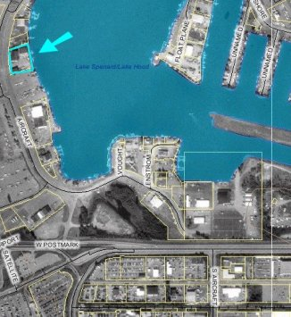
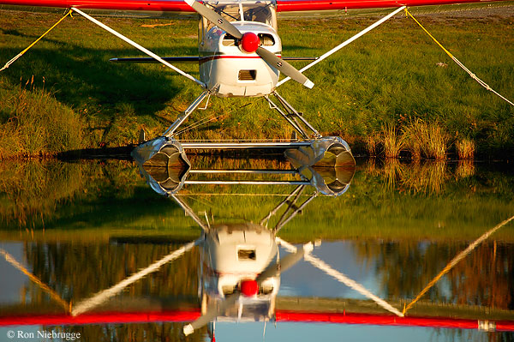
World’s Busiest Seaplane Base
Anchorage’s Lake Hood handles more than 600 take-offs and landings on a peak summer day

Slide 23
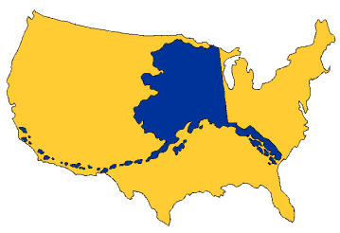
Land Area of the State
Alaska is the largest state in the country, with 586,000 square miles of land.
It is one-fifth the size of the lower 48 states
488 times larger than Rhode Island
two and a half times larger than Texas

Slide 24
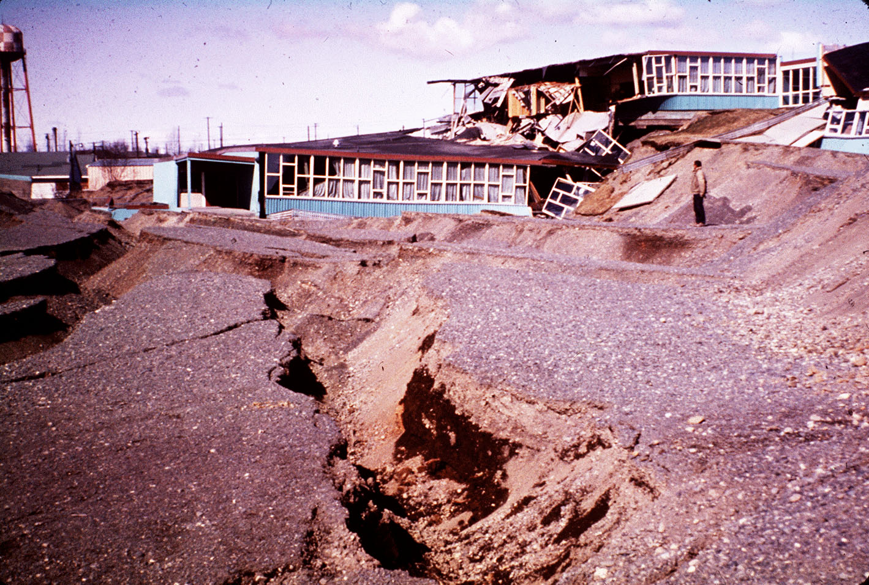
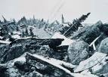
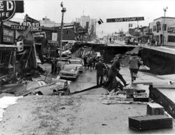
North America’s Biggest Earthquake
The Good Friday earthquake of March 27, 1964, with a magnitude rated at 9.2 on the Richter Scale

Slide 25
Alaska’s Current Governor
Mike Dunleavy

