Slide 1
Russian-American History
1741 - 1867

Slide 2
Russians Come to Alaska
Vitus Bering
Vitus Bering and Alexeii Chirikov
Russian Fur-traders
Settlements in Russian America
Gregorii Shelikov
Russian-American Company
Alexander Baranov

Slide 3
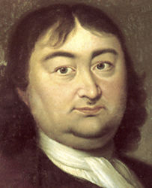
Vitus Bering
1st Voyage: 1725-1730
Sails through strait which now bears his name but does not reach the coast.
2nd Voyage: 1733-1741
St. Peter sailed by Bering
St. Paul sailed by Alexeii Chirikov
Both captains sight land
Bering dies after a shipwreck on the island that now bears his name.

Slide 4
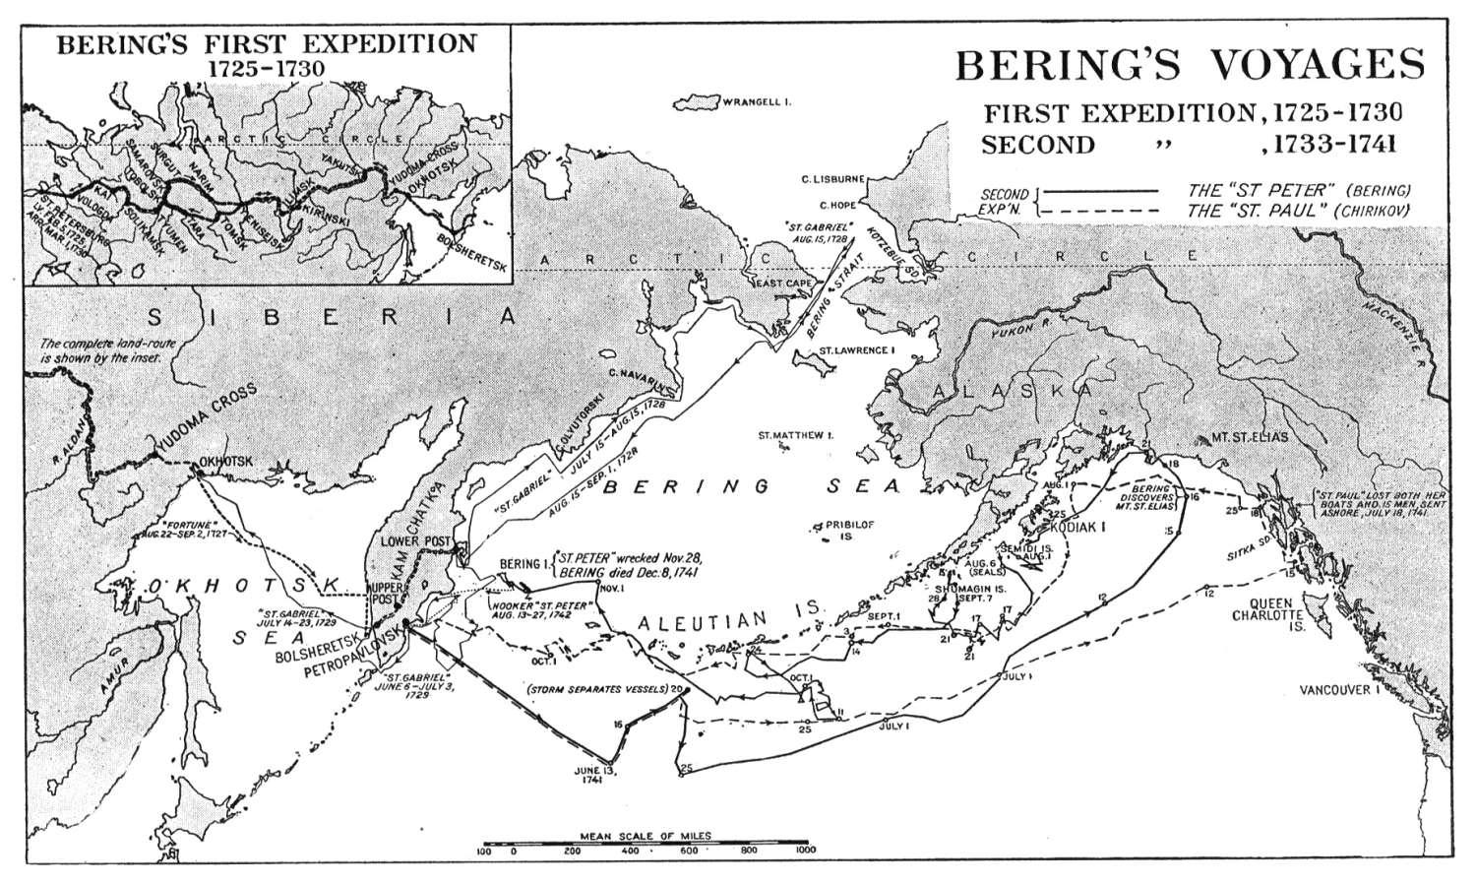

Slide 5
Vitus Bering’s and Alexeii Chirikov’s Voyage (1733-1741)

Slide 6
Fur Hunters Swarm to Alaska
Following Bering’s second expedition, Russians left the shores of Asia to go to the Aleutian Islands in search of furs.
Russian fur-trading voyages to Alaska began in 1743 starting at Bering Island.
By 1745, Russian traders had reached Attu Island and Agattu Island.
Within 20 years the Russians were at Unalaska seeking furs.

Slide 7
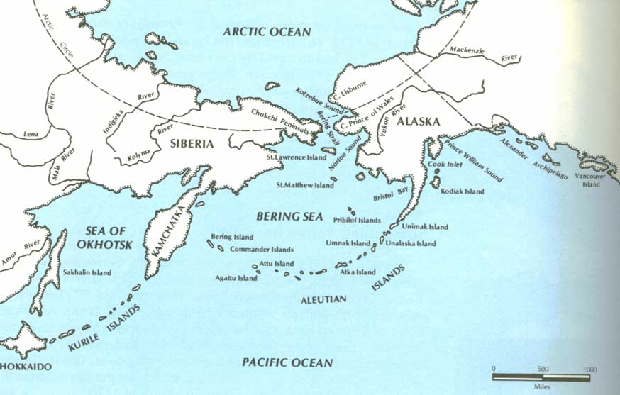

Slide 8
Furs are Basis of Russian American Economy
Between 1743 and 1799 over 100 Russian fur-hunting expeditions sailed into Alaskan waters
They returned with 187,000 pelts worth 8 million rubles (about 6 million dollars)
The fur trade was the Russians’ chief reason for coming to and staying in Alaska
Building and sailing ships, farming, fishing, logging, mining, and whaling were done to support the fur trade

Slide 9
Russian and Aleut Interactions
When the Russians arrived on the Aleutian Islands, they set up winter quarters.
Sometimes Russians traded with Aleut hunters to get sea otter furs from them.
More often, Russians forced the Aleuts to guide and hunt for them.
Russians often took Aleut family members hostage to insure the safe return of Russians who hunted with the Aleuts.

Slide 10
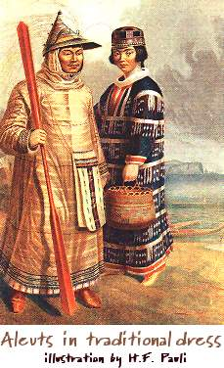
Aleuts Resist Russians
The Aleuts fought back by killing the crews of and destroying four Russian ships in the winter of 1763-1764.
The Aleuts were brave but the Russians had the advantage of firearms and lances.
Aleut villages, due to their scattered locations, were easy for Russians to attack.

Slide 11
Russians Trade Native Furs to the Chinese
First major interest was in sea otters
Fur seal pelts also were very popular in China
These pelts were highly prized by the Chinese
Aleuts and Alutiiq Eskimos hunted the sea otters for the Russians and killed them at sea
When the Russians learned that fur seals migrated to the Pribilof Islands, Aleuts were forced to live there so they could kill the seals at their breeding grounds

Slide 12
An Example of Russian Trade
Russian trader gives an Aleut woman trade goods worth 7 rubles for a squirrel parka
The Russian trades that parka to an Aleut hunter for furs valued at 10-15 rubles
Then the Russians trade the furs to Chinese merchants for tea, silk, and spices worth 60-70 rubles when sold in Russia

Slide 13
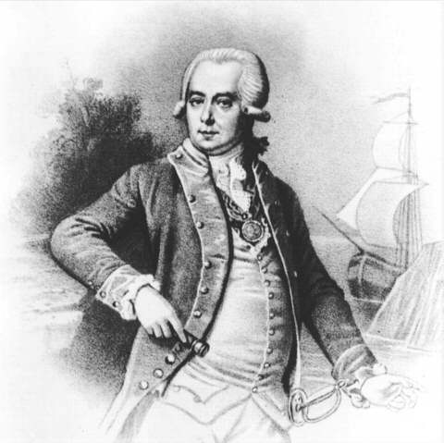
A Permanent Settlement
Gregorii Shelikov established the first permanent Russian trading post in Alaska.
Traders could trade year round.
Less traveling for the traders.
Furs could be stockpiled so ships returning to Russia could carry a full cargo.

Slide 14
Three Saints Bay
Three Saints Bay is significant because it was the first established settlement by Russians in what would become Alaska.
Gregorii Shelikov and his wife Natal’ia settled on Kodiak Island on what is now Three Saints Bay in 1784.
The Alutiiq Eskimos who lived on Kodiak Island fought the Russians, but to no avail.

Slide 15
Settlements Follow the Fur Trade
From this settlement, the Shelikovs sent fur-hunters into other parts of Southcentral and Southeast Alaska.
Later, settlements tended to be built along the paths of the Native trade networks or in strategic places.
Settlements also were established in California and Hawaii.

Slide 16
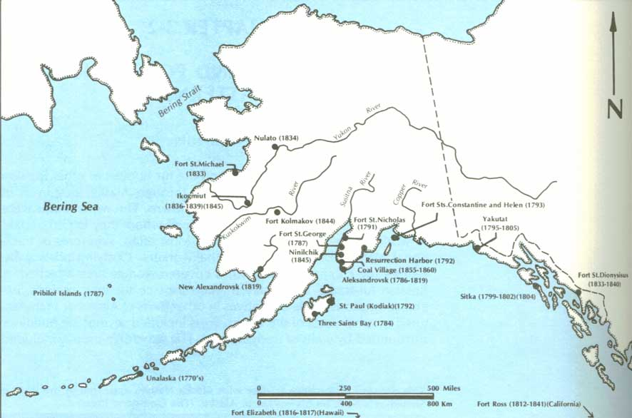

Slide 17
Alaska Natives and the Shelikovs
The Natives were organized into groups to do different kinds of work for the company.
Sea otter hunters: men
Bird hunting and bird egg collecting: old men and children
Cleaning fish, sewing parkas, and picking berries: women
Natives were provided a school so they could learn arithmetic and the Russian language to be better workers.

Slide 18
The Russian-American Company
In 1799, Tsar Paul I granted the Russian-American Company all rights to the fur trade and other resources of Alaska.
Although it was a business, this company also was part of the Russian government.
Its charter made it an independent government department that answered only to the tsar or tsarina.

Slide 19
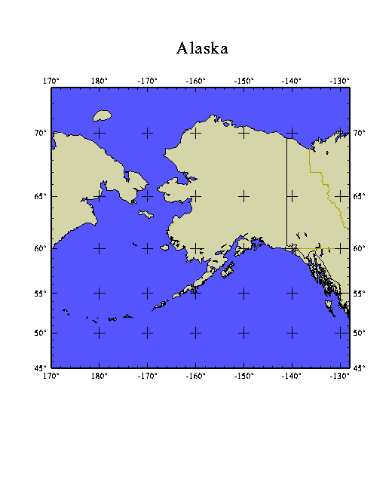
The Russian-American Company charter awarded use of all hunting grounds and settlements from 55 degrees North to the Bering Strait, and the right to establish new settlements north and south between these two boundaries.

Slide 20
The Russian-American Company Charter
The company could “use and profit by everything which has been or shall be discovered in those latitudes, on the surface and in the interior of the earth without competition from others.”
All Russians in Alaska united under the new company.
It was directed in Alaska by Chief Manager Alexander Baranov in Kodiak.

Slide 21
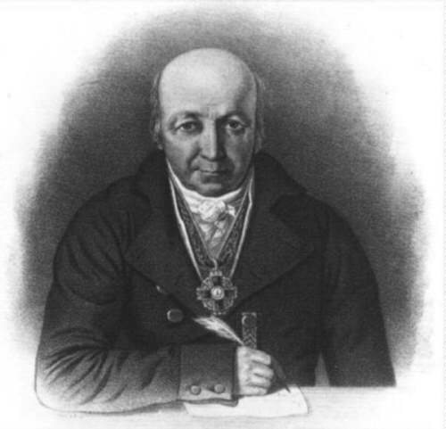
Old Sitka is Established
Baranov moved his headquarters by establishing Old Sitka in 1802.
Later that year, Tlingit Indians massacred 20 Russians and up to 130 Aleut workers at Old Sitka.

Slide 22
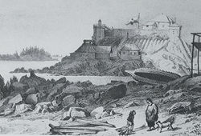
The Russian-American Company in Sitka
In 1804 Russians returned to Sitka and attacked the Kiksadi fort on the Indian River.
The Natives were forced to flee.
Baranov re-established the trading post at Sitka.

Slide 23
1847-1867
In the last two decades of Russian activity in Alaska, Alaska fur seal and sea otter catches declined.
While the catch of beaver and other land mammal furs increased, fur-trading profits declined.
During this time, the company tried to expand other economic activities to compensate for decreasing fur-trade profits.

Slide 24
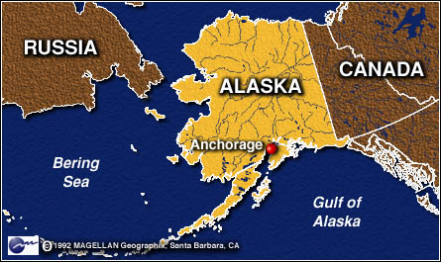
The United States Buys Russian-America
A treaty negotiated by U.S. Secretary of State William Seward buys Russia’s interest in what is now Alaska for $7.2 million, or about 2 cents an acre.

Slide 25
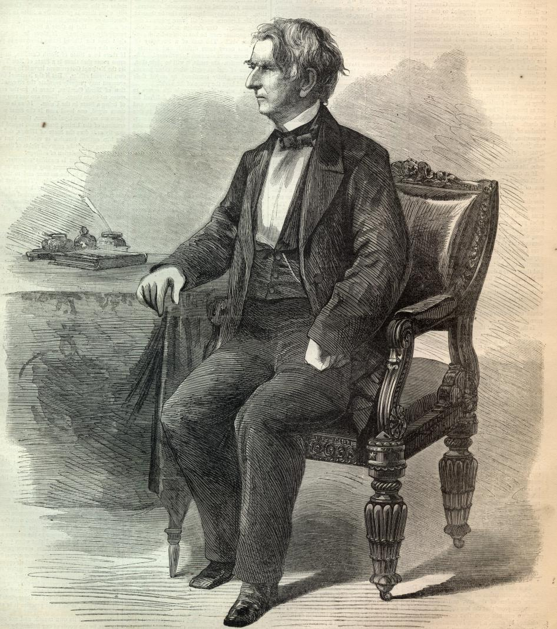
Seward’s Folly
Since Alaska’s value was not recognized by the American masses they referred to the purchase as “Seward’s folly.”

Slide 26
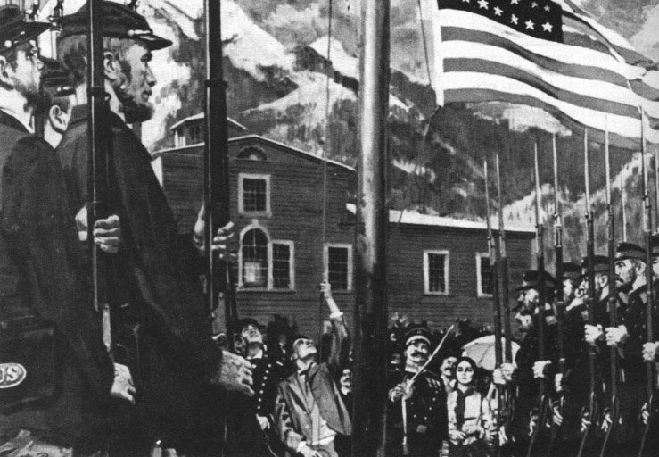
Raising the American Flag October 18, 1867 Sitka, Alaska

Slide 27
Something to Think About…
Did the Russians really have the right to sell, and the United States the right to purchase, Alaska?

